Slide 1
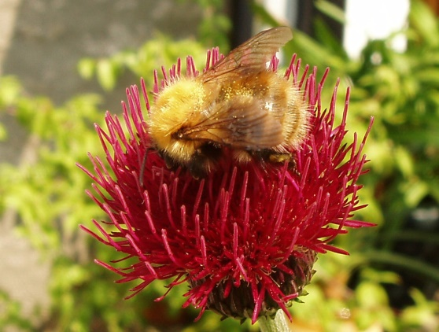
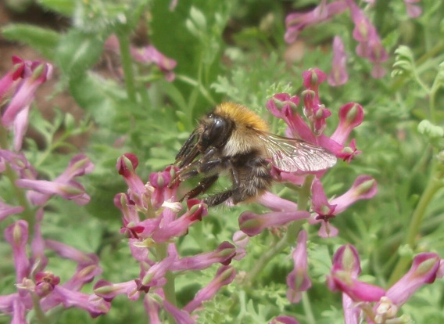
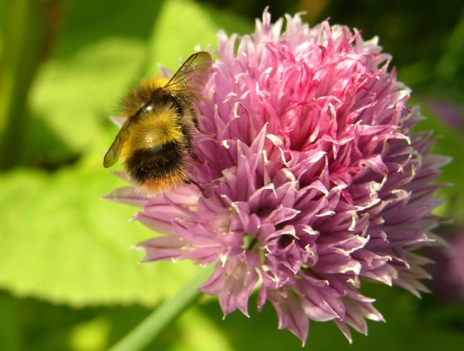
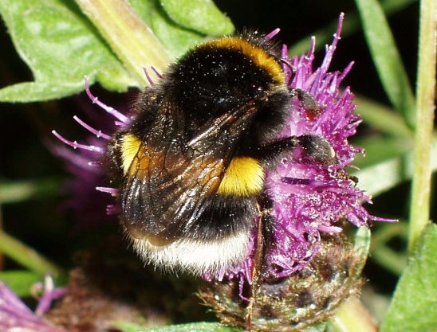
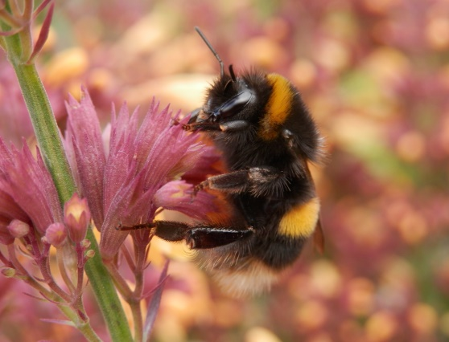
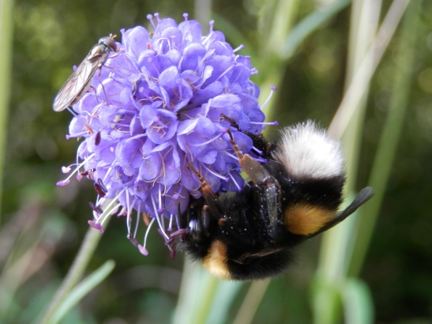
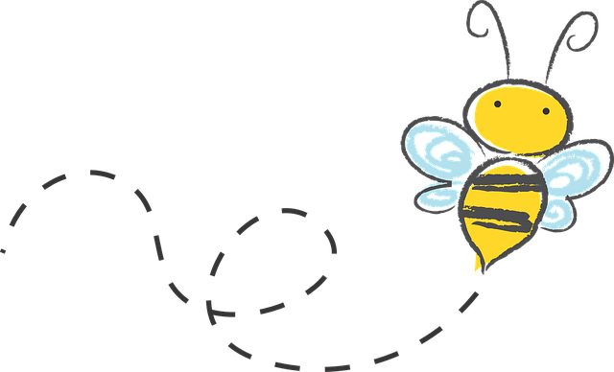
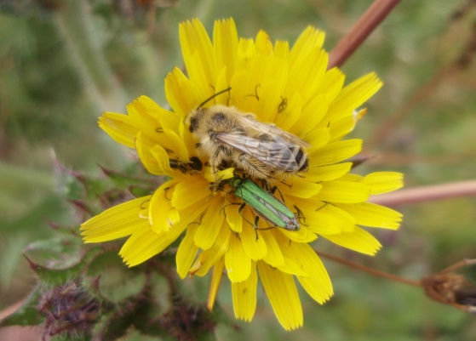
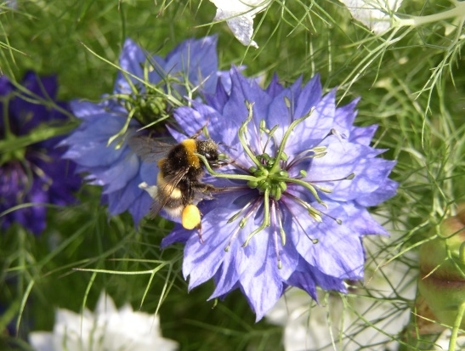
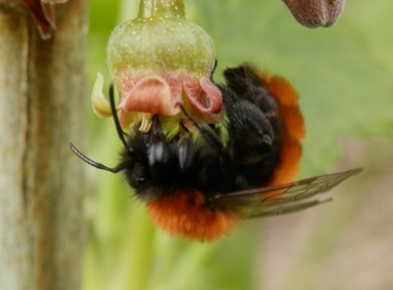
GET CUMBRIA
BUZZING
Recording
Your Findings
By Julia Pigott
© Julia Pigott

Slide 2
Accurate identification is important
Some of you will get BEEZOTTED
Generates useful & important information and data
Allows description of different ecological communities
Monitoring of changes
What works and is worth doing
What needs improving
Assists monitoring on a global scale
Climate change
Habitat changes
Allows accurate learning/researching about a species or habitat
We wouldn’t know we had a problem if we did not have good historic data

Slide 3
Biological Keys – plants, insects …… everything
For BEEZOTTED enthusiasts
Dichotomous Keys
This or that
Multiaccess Keys
Often computer based – smart phone
Allows input of what the observer has seen at the time
Photo ID e.g. PlantNet, iNaturalist
Bayesian (multi-access) keys
Identification based on how many characters match
This
White tail
That
Red Tail

Slide 4
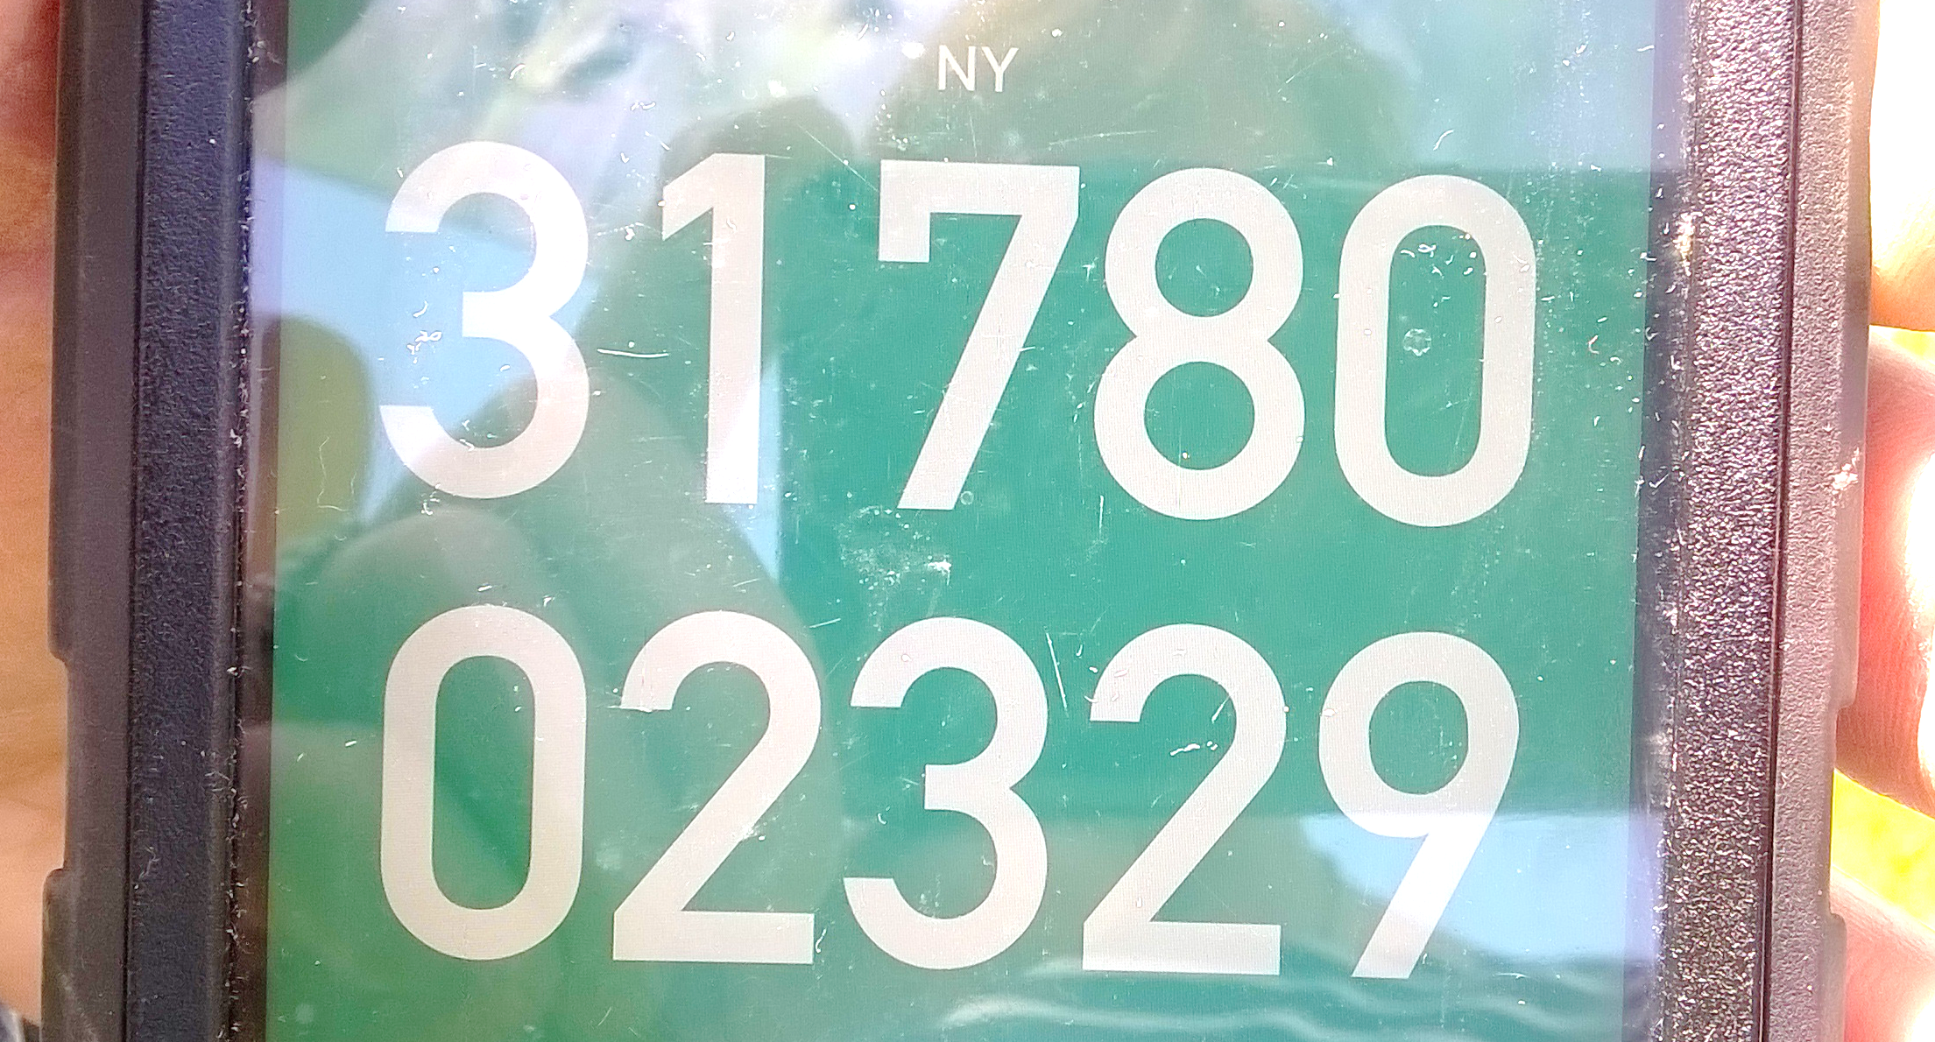
Photograph Have a good look Grid Reference
Map reference
Longitude/latitude
Post codes
Settings on your phone, your camera
or
get an App
Tube – glass 23mm across, 74mm long https://www.watdon.co.uk/
Plastic for kids

Slide 5
Get the best photo you can
Have a good look
First – from a distance
Second - get close
Third – more than one view
Face/legs/tail
Try to avoid getting your shadow on the insect
Move slowly
Keep the phone/camera still
Try to lock your elbows against your body
Rest your hand on something

Slide 6
https://www.streetmap.co.uk/

Slide 7
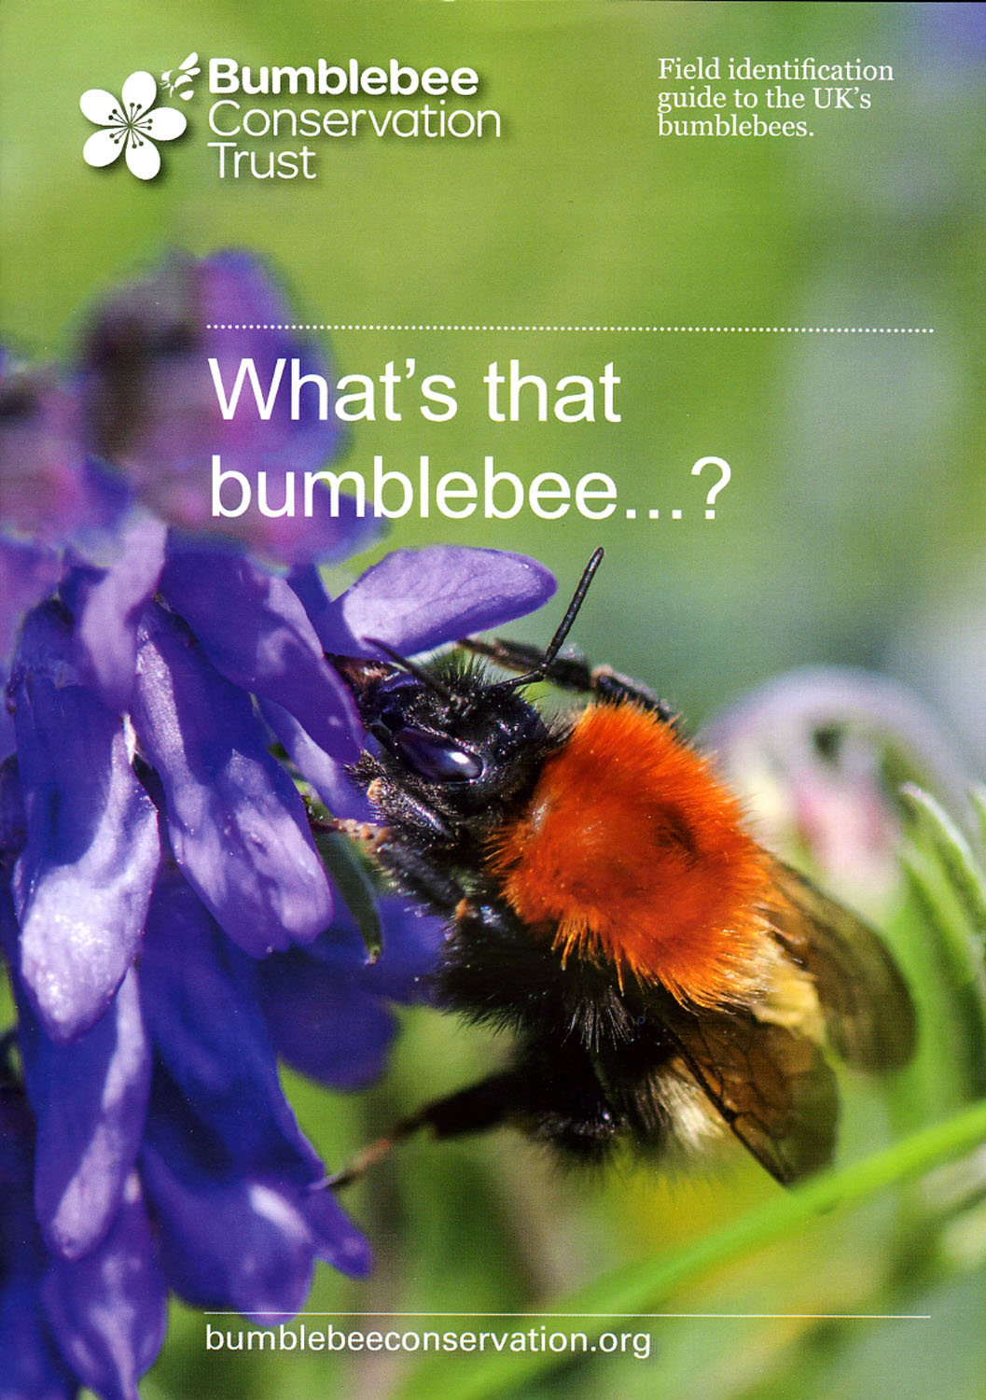
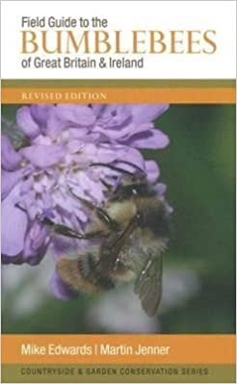
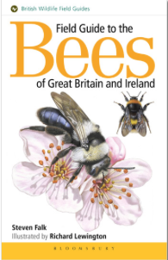
Identifying – start small
Bumblebees:
Brilliant once you have got started
ID charts
https://www.bumblebeeconservation.org/
Keep it simple, good place to start
Visible in bright sunshine, waterproof
No need for phone signal
Field guides
Stage 2
Other sources e.g. Bumblebee Conservation Trust & BWARS
Personal interest, gaining skills and understanding
Recording
Final phase – needs a decent photograph
On line for – ‘Citizen science and global biodiversity’ – Open University free courses
https://www.open.edu/openlearn/science-maths-technology/citizen-science-and-global-biodiversity/content-section-overview?active-tab=description-tab
ALL our bees:
For BEEZOTTED enthusiasts

Slide 8
Start Recording
For Get Cumbria Buzzing
https://www.cbdc.org.uk/recording-wildlife/
https://www.cbdc.org.uk/about-us/projects/get-cumbria_recording-the-buzzzing_page/
https://www.inaturalist.org/
https://www.brc.ac.uk/irecord/
Have a look at other sites to learn, understand and expand knowledge
Join BWARS on Facebook
Brilliant for learning
https://www.brc.ac.uk/scheme/bees-wasps-and-ants-recording-society

Slide 9
